Slide 1





2nd Scientific Conference on Medicines Regulation in Africa
30 Nov-01 December 2015, Addis Ababa, Ethiopia
The role of regulatory interventions in improving access to quality pharmaceutical services: Lessons learned from accredited drug seller initiatives in Tanzania, Uganda, and Liberia

Slide 2
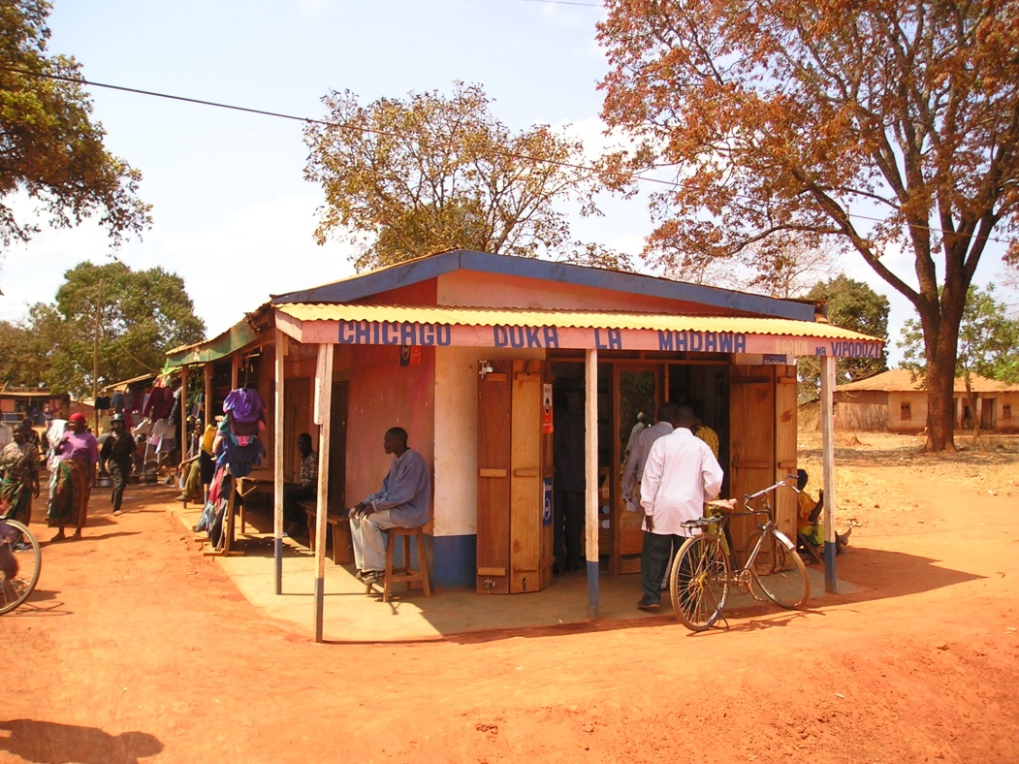
Drug Sellers—Opportunity for Improved Access
First choice for 45+% of medicine purchases
Over 9,000 drug shops compared to nearly 800 registered pharmacies in Tanzania
Close proximity—95% of population within 5 km of a drug shop
Perception of being more personal; flexible payment methods
Public health facilities often farther away; essential medicines often out-of-stock

Slide 3
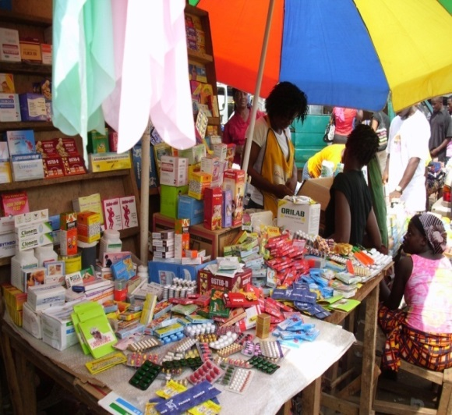
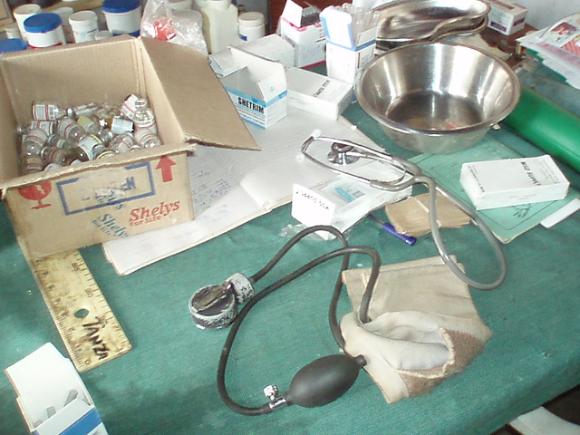
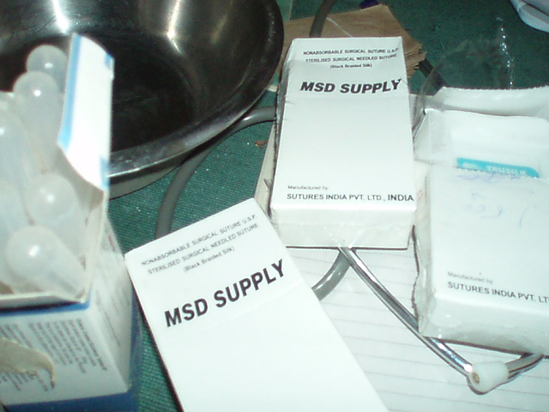
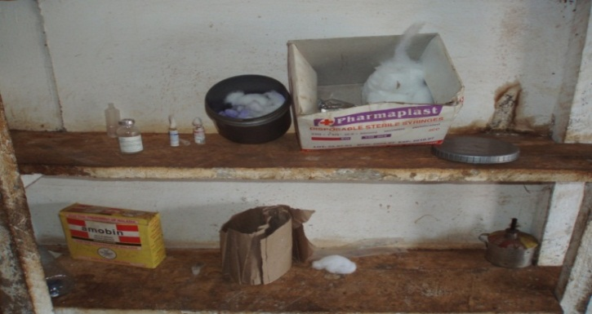
Medicine Access and Drug Sellers—
The Problem
Unqualified, untrained staff
Sale of unauthorized products
Poor medicine storage conditions
Unknown medicine quality
Unreliable supply of medicines
High medicine prices
Inadequate regulatory enforcement mechanisms
Insufficient variety of legally available medicines
Notes:
In Africa, many people buy medicines from the most convenient source, which is usually the local drug dispensing outlet. In Tanzania, duka dawa baridi, in Ghana, the chemical seller shop, in Uganda, the drug shop, in Liberia the medicine store, in Zambia the health shop
These drug outlets dot the countryside, especially in rural areas where the number of licensed pharmacies is extremely limited.

Slide 4
Drug Sellers—The Strategy (1)
Gain broad-based support from stakeholders
National and local authorities, professional and commercial associations
Develop standards and regulations and build capacity
Create standards
Engage private sector and build capacity
Provide incentives and support
Participatory approach to design and implementation
Strengthen regulatory capacity
Develop local strategy for inspections with central oversight
Business skills of owners
Dispensing, record keeping communication skills for shop attendants
Ability to legally sell expanded range of medicines
Loans
Continuous program review
Formation of associations
Use of mobile technology to facilitate business
Notes:
Holistic approach―standards setting, training, incentives, regulatory enforcement, supervision, and consumer advocacy to improve access and use and help assure sustainability
Broad stakeholder engagement to promote ownership and sustainability
Continuous program implementation and standards review to reflect consumer needs (eg updating the list of legally allowed medicines for dispensing)

Slide 5
Drug Sellers—The Strategy (2)
Ensure availability and quality of products dispensed
Stock products approved by national drug authorities
Ensure quality of pharmaceutical services provided
Record keeping
Marketing
Enhance availability of local suppliers/ wholesalers at regional and district levels
Mentoring and supervision
Increase patient and consumer awareness and empowerment
Information and education
Continually monitor product availability and quality
Empower consumers to seek quality health services
Consumer charter
Regular reporting for target indicators
Refresher training as needed
Notes:
Continuous monitoring of availability and quality of products through supervisory visits, research, mystery shopping and in future - mobile reporting
Key message: Accredited drug seller initiatives is one among the programs that takes a holistic approach to address drug seller problem through a “package of interventions” that includes regulatory enhancement, providers skills and behavior, incentives and consumer education

Slide 6
Tanzania’s ADDOs from Concept to Scale-up
2001-2003 Assessment, program design, conceptuali-zation, and planning
2004-2006 Pilot program M&E
2006-2008 Program scale-up (centralized approach)
2003-2005
Pilot program in Ruvuma region
2008-2013 Program scale-up
(decentral-ized approach)
2006-2013
Program maintenance and sustainability; public health intervention integration into the ADDO program
Notes:
Model piloted and evaluated in Ruvuma region during 2003–2004; plans for national scale up started in 2006
Continuous program implementation and standards review to reflect consumer needs (e.g., updating the list of legally allowed medicines for dispensing)
After 10 years of effort from central and local governments and development partners, nationwide scale-up completed in June 2013

Slide 7
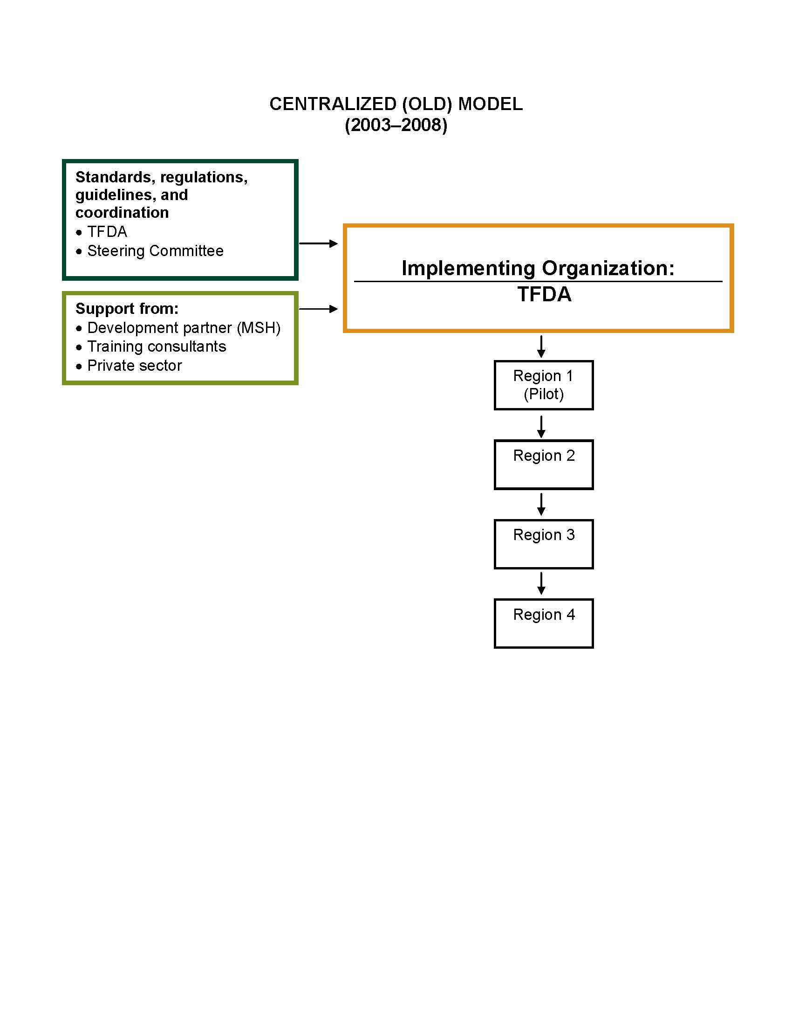
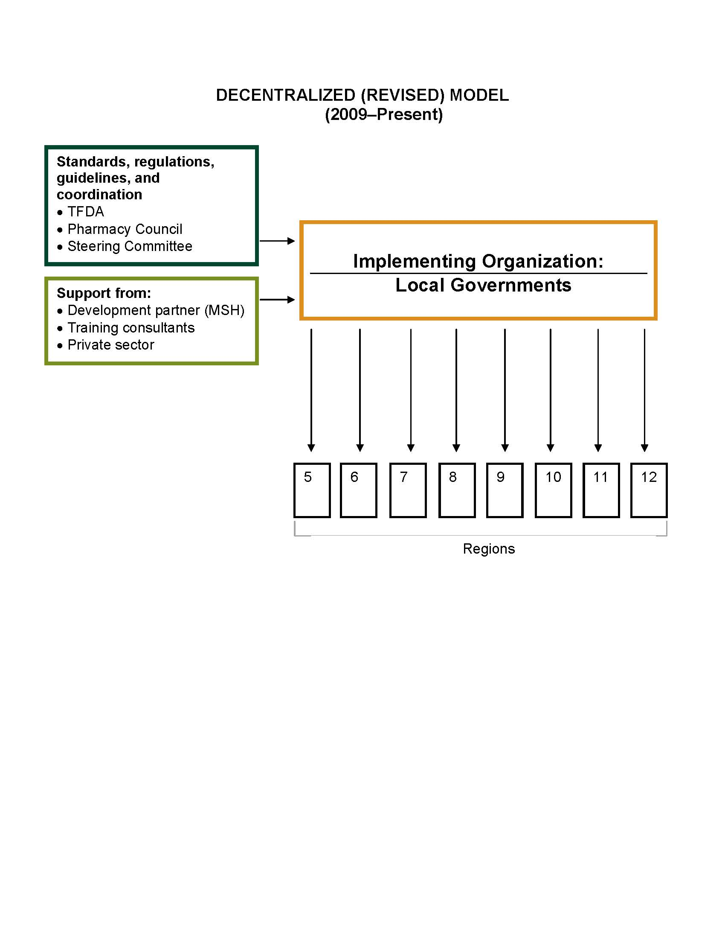
Decentralized Implementation to Support Scale-up
Notes:
Reduction of implementation cost by 50%
While it took Tanzania six years to roll out ADDOs in four regions using the original model, an additional 17 regions completed implementation since 2009 using the new decentralized approach.
Using the revised model has decreased rollout time from an estimated 18 months to less than 12 months per region

Slide 8
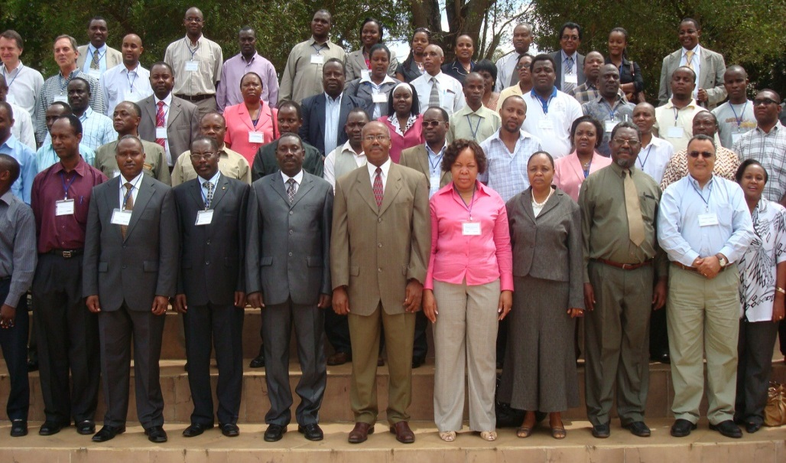
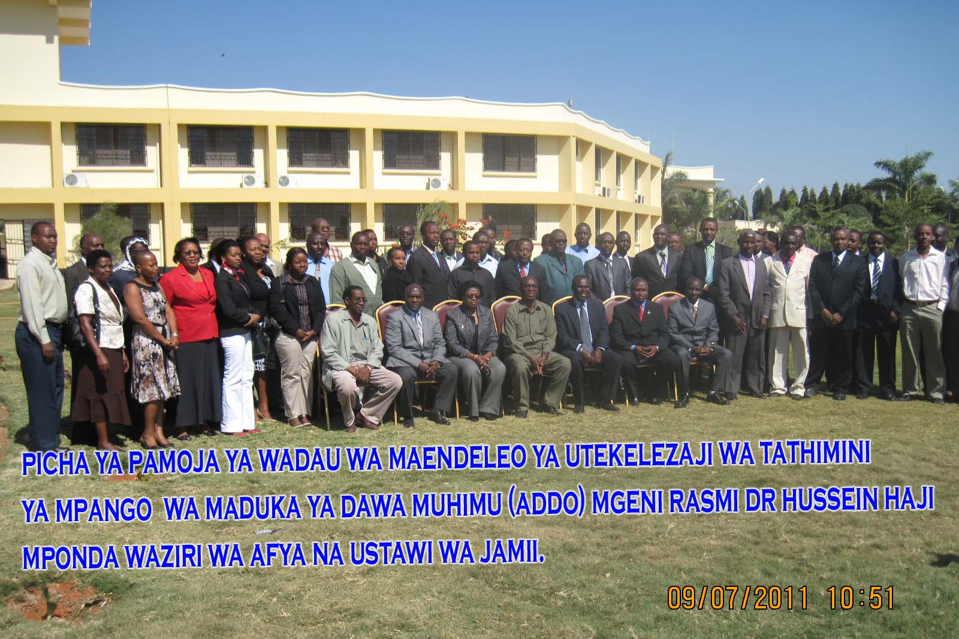
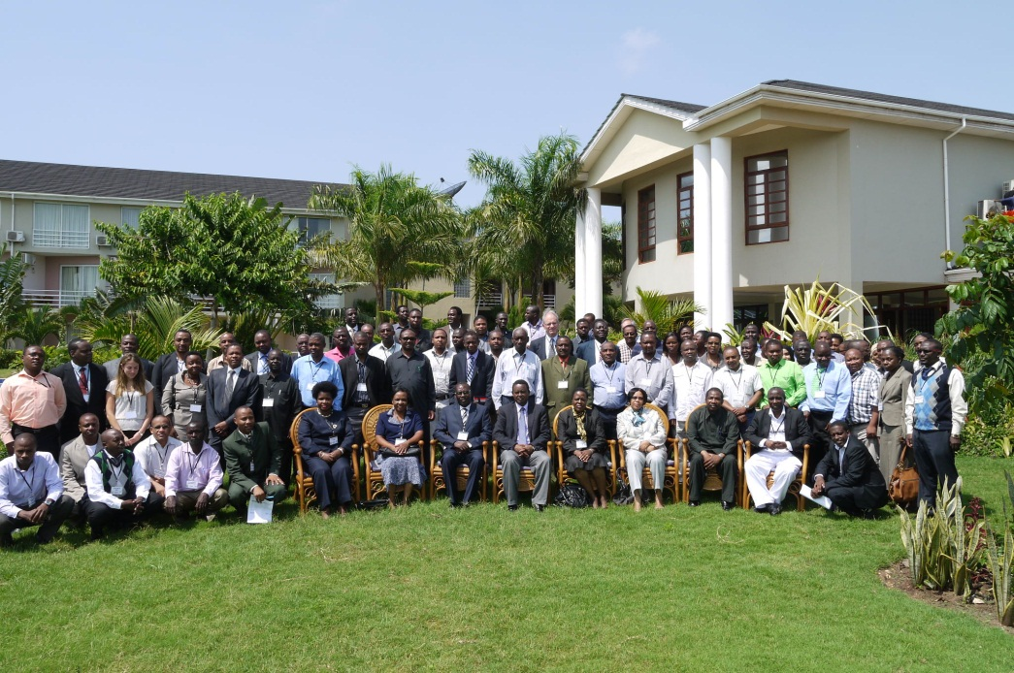
Stakeholder Engagement: The Linchpin of Success and Sustainability
Notes:
Continuous monitoring of availability and quality of products through supervisory visits, research, mystery shopping and in future - mobile reporting

Slide 9
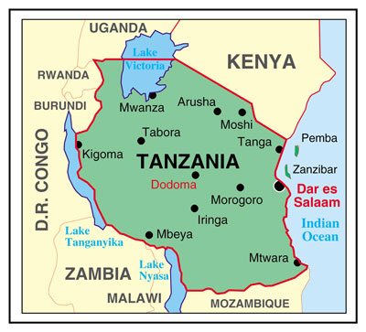
Tanzania’s ADDO Program Status
As of August 2015
Regions scaled up | 25
Shops accredited (ADDOs) | >8,000
Shops in accreditation process | >2,000
Trained dispensers | >19,000
Trained district inspectors | >500

Slide 10
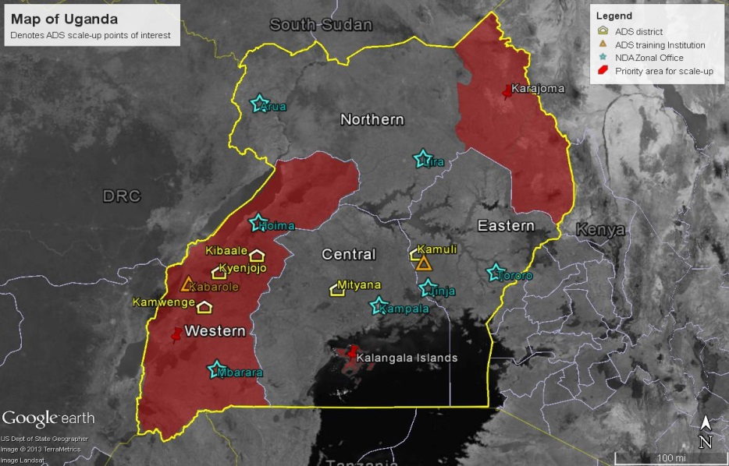
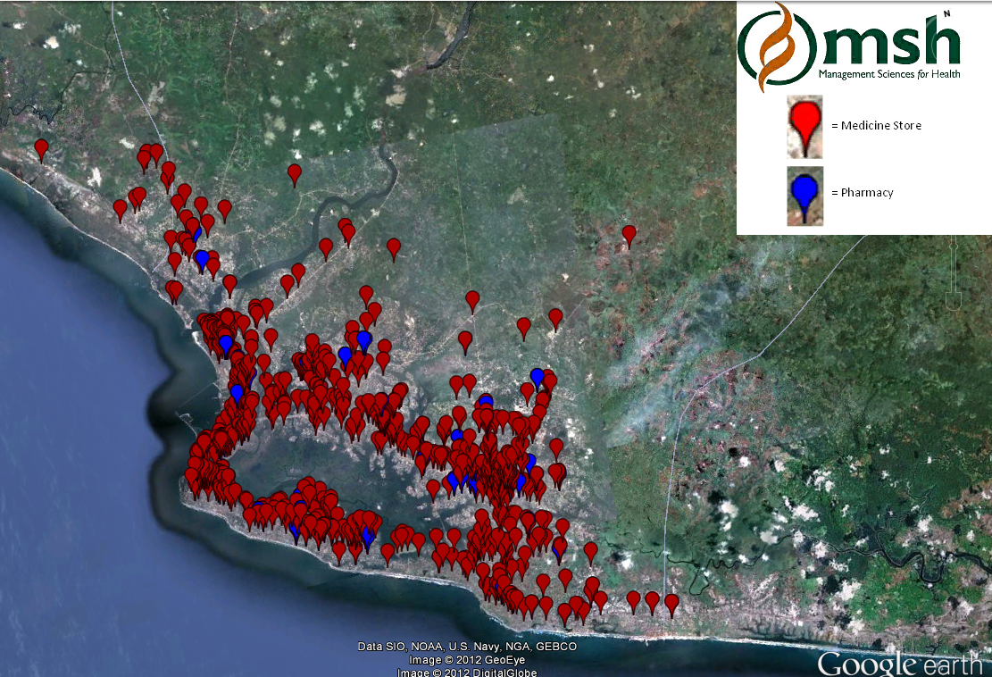
Transfer of the ADDO Model to
Uganda and Liberia
As of January 2015, Uganda had
689 Accredited Drug Shops (ADS) in 9 districts and training completed for 1330 ADS sellers, over 600 ADS owners, and 93 local drug monitors
As of January 2015, Liberia had
125 Accredited Medicine Stores (AMS) and 174 shops awaiting accreditation in Liberia’s most populous county and training completed for 628 AMS sellers, 160 owners, and 17 inspectors

Slide 11

Basis for Accredited Drug Seller Accreditation
Regulation, inspection, and sanctions
Application vetting
Premises standards and infrastructure approval
Personnel standards, training, and licensing
Drug quality and availability
Supervision and monitoring
Record keeping and reporting
Notes:
Continuous monitoring of availability and quality of products through supervisory visits, research, mystery shopping and in future - mobile reporting

Slide 12
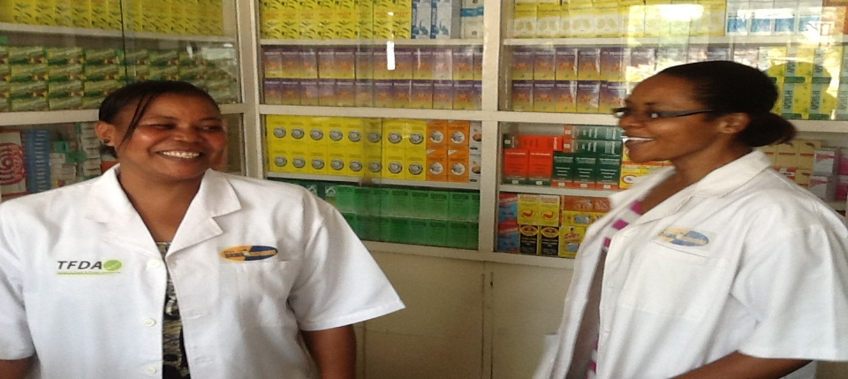

Scope of Services and Required Training
Laws, regulations, and code of ethics
Good dispensing practices and rational medicines use
Common medical conditions in the community
Maternal and child health (ICMI); nutrition
Reproductive health
HIV/AIDS; TB case detection
Chronic care
Reportable conditions (e.g., Ebola, cholera)
Communication skills and counseling; reporting
Notes:
Continuous monitoring of availability and quality of products through supervisory visits, research, mystery shopping and in future - mobile reporting

Slide 13
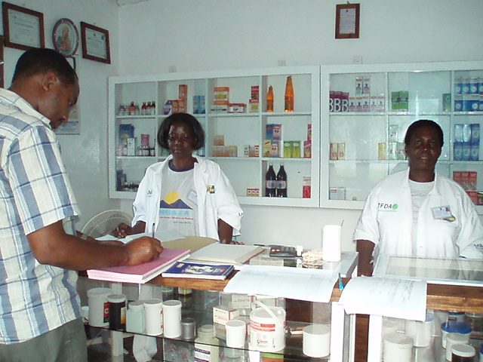
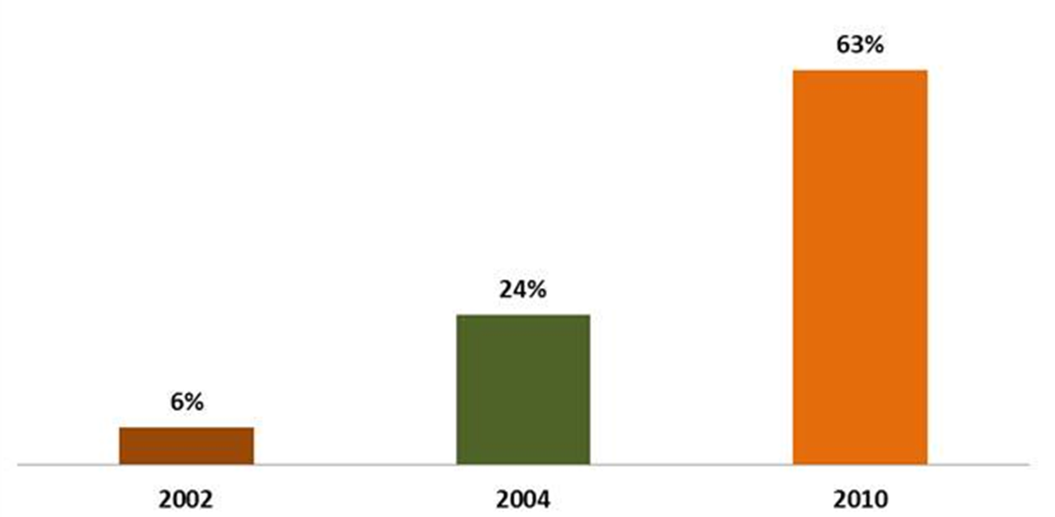
Quality of Pharmaceutical Services: Malaria Treatment in Tanzania
% Encounters receiving appropriate malaria treatment in Ruvuma region: 2002-2010
Notes:
Before accreditation (in 2002), 6% of malaria encounters in drug shops were treated according to treatment guidelines; after the pilot (in 2004), 24% were treated correctly; in 2010, the rate was 63%--a 950% improvement.

Slide 14
Quality of Pharmaceutical Services:
Availability of Injections in Uganda
Notes:
In Uganda, the percentage of shops offering injections (which is illegal), fell from 61% to 0 after accreditation in the pilot district.

Slide 15
Quality of Pharmaceutical Products in Liberia
Notes:
In Liberia, the percentage of expired, damaged, or counterfeit products on the shelves of medicine stores went from 28% at baseline to 8% at endline.

Slide 16
Program Maintenance and Sustainability Beyond Scale-Up
Private sector responsible for all business-related costs; central and local governments budget for regulatory costs (partially off-set by shop and personnel license fees)
Training institutionalized through health training institutions in Tanzania and Uganda
Mobile technology has improved ADDO regulatory system and services
  Fees collected through mobile money, data collection and reporting, information exchange
Drug seller provider associations improve: communication, coordination, product price and availability, quality of service through peer supervision

Slide 17
Key Lessons Learned (1)
Access to essential medicines and pharmaceutical services can be substantially improved through targeted training, accreditation, and regulation of private-sector drug sellers
Even prescription drugs can be rationally dispensed at grass roots drug outlets
Periodic inspection and monitoring is mandatory to support improvement in regulatory adherence and rational dispensing and use
For program success, broad-based support from stakeholders (public/private) is necessary

Slide 18
Key Lessons Learned (2)
Participatory approach to project’s design and implementation is crucial
Building on existing system/framework (public/private) and appropriate incentives to support commercial success is vital for sustainability
Regulatory authority decentralization is very promising but needs enabling and resource commitment
Supervision and monitoring are complex, time consuming, and still pose an enormous challenge to implementing countries

Slide 19
Facilitating Accredited Drug Seller Initiative Expansion
MSH has received a grant to facilitate expansion of accredited drug seller initiatives in Africa (LaunchDSI)
LaunchDSI will use three mechanisms to assist interested countries:
  Information and guidance: Determine feasibility of adapting the accredited drug seller model
  Technical assistance: Develop capacity to carry out implementation of an initiative
  Small start-up grants: Help a limited number of countries move forward with planning
LaunchDSI has created a resource center located within the MSH Tanzania office
Expressions of interest are now being solicited
Notes:
LaunchDSI will use three mechanisms to assist interested African countries in relation to establishing an accredited drug seller initiative.
(1) Information and guidance—For countries just getting started, LaunchDSI will be available to provide guidance as to the feasibility of adapting Tanzania model, planning and implementing it, and accessing funds necessary to start work. LaunchDSI has created a resource center located within the MSH Tanzania office in Dar es Salaam. It serves as a repository for training materials, reports, publications, and information on funding sources and donors, as well as the providers of technical assistance.
(2) Technical assistance—LaunchDSI staff, consultants, and implementing partners will be available to help countries develop the capacity to carry out planning, implementation, and maintenance of an accredited drug seller initiative. The availability of technical assistance will need to be determined through dialogue with each interested country since funding and staff availability limitations will come into play.
(3) Small start-up grants—LaunchDSI will be able to provide several small start-up grants to countries that are committed to moving forward with development of an accredited drug seller initiative. Selection of grantees will be made through dialogue with interested countries to assess need, whether there may be potential leveraging funding from other sources, and commitment to move forward.

Slide 20

Asante Sana!
www/LaunchDSI.org

