Slide 1
Task Sharing to Drug Shop Operators for Provision Injectable Contraception by in Uganda

Slide 2
Presentation Outline
Introduction , background and timeline of events
Problem statement
Rationale
Summary of evidence from research and pilots
Anticipated challenges and proposed actions

Slide 3
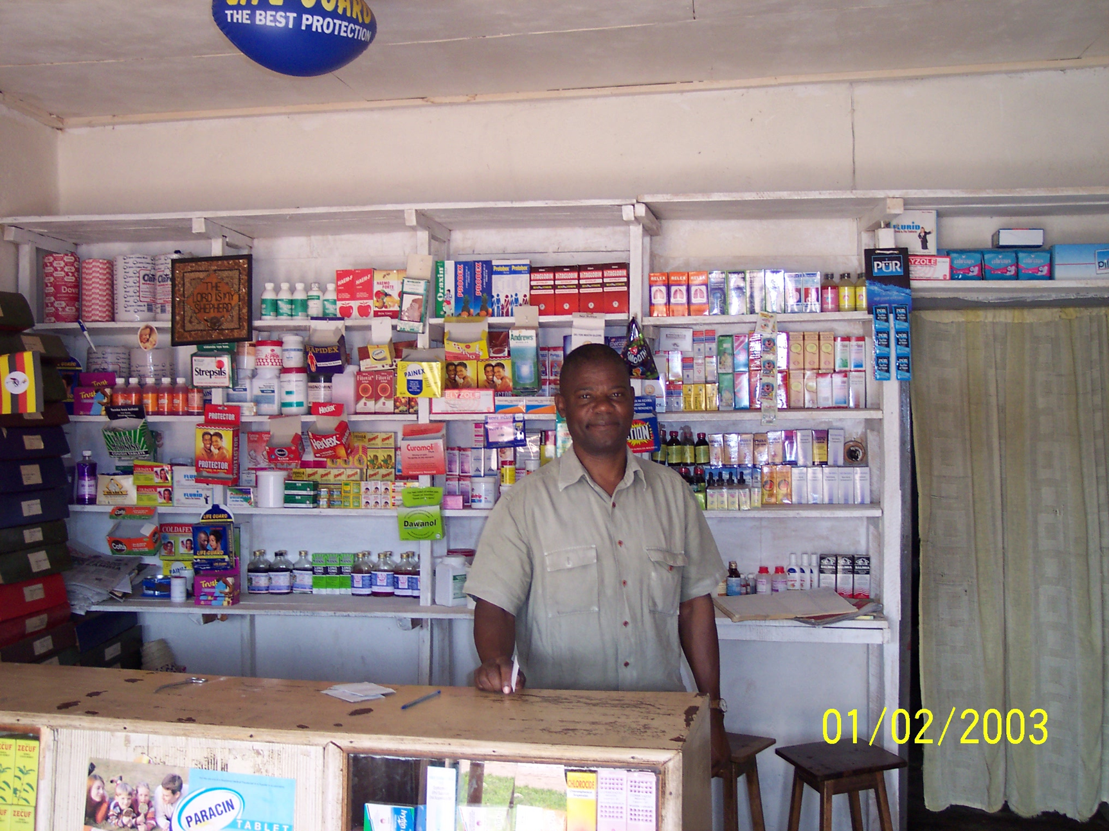
Introduction
Source: John Stanback, Uganda
Notes:
Since 2007 the Ministry of Health (MOH) has worked with FHI 360 and other partners to conduct three studies to assess the suitability of drug shops to sell and administer injectable contraceptives in Uganda.
A stakeholder engagement in September, 2014 recommended writing of a brief, documenting the research and recommendations on the delivery of injectable contraception by Drug Shop Operators in Uganda.
A high level policy dialogue meeting on the 5th of June 2015 which discussed the research and policy brief and obtained stakeholder consensus on a policy change for Injectable FP provision through drug shops.
A task force committee was formed in July 2015 with representatives from the National Drug Authority (NDA), Ministry of Health (MOH) Pharmacy Division and Reproductive Health Division and CSOs.

Slide 4
Timelines and process
2007 to 2014 - Studies and pilots were done.
2014 – Technical consultation done in North Carolina
June 2015-High level policy dialogue held to review Ugandan evidence recommends formation of task force.
July 2015-Task force including NDA,MOH(Pharmacy and RH and CSOs) starts consultations and work on justification paper.
August 2015-Consultations held with Professional Bodies.
March 2016- Justification Paper presented to MCH Cluster and recommended for presentation to MOH Senior Management
July 2016-Presented to EmONC Task Force for input.
August 2016-Presented justification Paper to MOH SMC

Slide 5
Problem Statement
Uganda has high fertility rate of 5.8 (National Population and Housing Census 2014)
Unmet for Family Planning remains high-34.3% (UDHS,2011)
Modern Contraceptive Prevalence is still low 26% ( UDHS ,2011)
Family Planning service coverage is still low, cannot enable us to reach the Uganda FP CIP goals of 50% Modern Contraceptive Prevalence Rate and reducing unmet need to 10% by the year 2020.
Drug Shops if used as an additional channel can therefore make an important contribution in attaining the national Family Planning goals.
Notes:
-By lowering fertility and child mortality rates, Uganda will be better placed to harness the demographic dividend for economic growth.
-The above stats are based on UDHS 2011.
- PMA 2015 puts mCPR at 30% , a slight increase, but need to attain 20 percentage points to reach FP 2020 /FP CIP goal of 50%
PMA 2015 puts Unmet at 31.8%, again a slight decline, but still need to attain about 20% percentage points to attain FP 2020/FP CIP goal of 10%.
Barriers more acute in rural areas where health facilities tend to be few and far apart. Not surprisingly, women in rural areas have almost twice as many children as women in urban areas.

Slide 6
Rationale
Injectables are a highly used and preferred method
Task sharing to VHTs already endorsed and they provide injectables in Uganda.
Drug shop operators, can deliver injectable FP if trained.
9,724 registered drug shops in Uganda (NDA, Feb 2015) and widely distributed.
If approved to provide injectables they would relieve pressure from Health Facility staff, would increase access since they are readily found in rural areas and have extended hours of operation.
Despite the advantages current policy framework does not permit them to offer injectable contraception.
Notes:
Injectables are among the most effective contraceptive methods, after intrauterine devices, implants, and sterilization(UDHS 2011). The majority of injectable clients in Uganda use Depo Medroxyprogesterone Acetate (DMPA) an intramuscular injection of 150 mg given every 13 weeks or Sayana® Press (SP), a subcutaneous formulation of DMPA in Uniject™ which is simpler to administer.
With task sharing, a concept endorsed by the World Health Organization (WHO), persons with less training, such as drug shop operators, can deliver some health services with the same quality as providers with more training. This practice allows better use of highly trained workers and expands service delivery (WHO, USAID, and FHI 2010; Stanback et al. 2010). The MOH has already sanctioned provision of the injectable contraception by village health teams and many drug shops operators have equal or greater qualifications.
A study by Anthony K Mbonye et.al (2013) found that 68 % of the drug shop staff in Mukono district were qualified health workers. Further that 71% of the drug shop operators were registered with NDA and the other half with the District Dug Inspectorate (DDI).

Slide 7
Global evidence
Bangladesh-Blue Star trained Drug Shop operators to provide injectables
Nigeria-Patent Medicine Vendors provide contraceptives-although not injectables
Tanzania-The Accredited Drug Dispensing Outlet(ADDO) demonstrated that interventions with drug outlets could be scalable
Liberia-Adopted the Tanzanian ADDO model with 200 Medicine Stores.
WHO-recognizes provision of Contraception through Drug shops and pharmacies as a best practice( HIPS,2013).
Notes:
Small commercial drug shops and pharmacies are often the first line of health care in poor countries, especially in rural areas that have very few private or public clinics (Stanback et al., 2011). Drug shops (also known in some countries as chemist shops or patent medicine vendors), in contrast to pharmacies, are usually more numerous, do not typically employ a trained pharmacist, and are legally allowed to sell only nonprescription drugs and prepackaged medicines. Education and training of drug-shop staff vary widely from country to country and within countries. Like pharmacies, many drug shops also sell over-the-counter family planning methods, especially condoms and oral contraceptives.
Injectable contraceptives are the most popular contraceptive method in sub-Saharan Africa but can be difficult for people in rural areas to obtain from the public sector because of limited access to clinics, acute staff shortages, and stockouts. Injectables are widely available in pharmacies, often at very low prices, as part of organized social marketing programs. Pharmacies are scarce or nonexistent in rural areas where the majority of people in many low-income countries still live.
Drug shops could offer opportunities to expand access to family planning because they are commonplace in rural areas and privately owned and support a sustainable commercial market for health products.
Recent pilot studies on expanding access to contraception and specifically injectable contraceptives through drug shops have had very positive findings:
Some drug shop owners have the prerequisite knowledge and skills to be successfully trained to stock and administer injectables safely and to refer clients to health facilities, as demonstrated in a study of accredited drug-dispensing outlets in Tanzania (S. Mfinanga, C. Lasway, A. Kahwa, E. Ngadaya, S. Mujaya, and G. Kimara, unpublished data).
Women in Tanzania obtaining contraceptives at drug shops were able to self-screen for contraindications to combined oral contraceptives nearly as well as nurses could (Chin- Quee et al. 2013). This has implications for injectable contraception because they have fewer medical contraindications than combined oral contraceptives.
In Ghana, a pilot study demonstrated that drug shop staff could sell the socially marketed injectable contraceptive DMPA and refer clients for safe injection elsewhere (FHI 360 2013). Using this evidence, there is ongoing advocacy to expand the list of medicines sold at licensed chemical shops to include DMPA.
Drug shop operators have been trained to safely provide a wide variety of family planning methods, including injectable contraceptives. For example, the Blue Star Program in Bangladesh has demonstrated that when trained and supported, private sector workers, such as drug shop staff, can safely and effectively provide quality family planning services, including injectable contraceptives (T. U. Khan, S. Malarcher, S. Ahmed, S. Sarker, and M. Arevalo, unpublished data).
The Accredited Drug Dispensing Outlet (ADDO) program in Tanzania that was designed to improve access to affordable, quality medicines and pharmaceutical services in retail drug outlets in rural or peri-urban areas where there were few or no registered pharmacies demonstrated that pilot interventions with drug outlets can be scalable, sustainable, and transferable to other country contexts.
Research from Nigeria confirms that Patent Medicine vendors (PMVs) play an important role in the delivery of contraceptive services. Several studies have explored the role of PMVs in offering family planning services in general, but none have specifically assessed the contributions of PMVs to the delivery of injectable contraceptives. A study in select areas of Oyo State found that fewer than half of PMVs had ever received any form of training on how to provide family planning services. However, almost all the PMVs provided family planning services despite their lack of training, and 21 percent sold or administered injectables,

Slide 8
Local evidence
An assessment of drug shop suitability for socially marketed injectables “injectaplan” in Nakaseke, Luwero and Nakasongola found that:
>90% Drug Shop Operators were selling and injecting DMPA
Most Drug Shop Operators have some medical training
(Stanback et.al,2011, FHI 360 and Save The Children Uganda)
A follow-up assessment of trainings for a subset of Drug Shop Operators in Luwero and Nakasongola on family planning, safe injection and waste management found that:
Drug Shop Operators improved from baseline to end line on knowledge of FP, management of DMPA clients, waste management and in safe injection practices.
Trained drug shop operators were able to safely administer injectables.
(Dawn Chii et.al ,2010 FHI 360 and Save The Children Uganda)
Notes:
1. Assessment of drug shop suitability for sales of Injectaplan. The survey findings showed that:
The majority of drug shops operators were female, most had some medical training (most often as a nurse or nursing assistant), and most had completed senior 4 level of education.
Drug shops were a major provider of health care and the majority sold (85%) and injected (96%) DMPA in their shops.
Training was needed on injection skills and the delivery of family planning services in general because the drug operators’ knowledge of DMPA’s side effects varied, fewer than half had sharps boxes, and about 24% had received needle stick injuries.
2. Follow-up assessment of subset of DSO. The findings demonstrated that:
Trained drug shop operators improved from baseline to follow-up on scores for general knowledge about contraception, method provision, and DMPA; their scores for administration of DMPA also increased from baseline to follow-up. However, the improvements were not statistically significant compared to the control group in injection practice and knowledge.
Drug shop operators in both the intervention and control groups demonstrated that they were able to safely administer the injectable, but their general knowledge of family planning, management of DMPA clients, and ability to counsel clients could be improved.
With training, community-level distribution through drug shops is safe and feasible.

Slide 9
Local evidence continued
3. An assessment of drug shop contribution to FP service provision through interviews with clients and review of service statistics between September,2010 and June 2011 in four districts found that:
Almost half of the drug shop clients had switched from other providers (primarily government health clinics) mostly because of good quality service, convenient locations, shorter waiting times, affordability and fewer stock-outs at the drug shops.
Between April and June 2011, clinics, CHWs, and drug shops in four districts delivered equal proportions of couple-years of protection, with drug shops leading marginally at 36%, followed by health facilities (33%) and CHWs (31%). (FHI 360 and USAID/STRIDES)
Notes:
3. Assessment of drug shop contribution to FP service provision. The evaluation findings showed that:
Drug shop operators provide an equivalent amount of family planning services (as measured in couple-years of protection) in three of the four districts assessed compared to Village Health Teams and clinics.
Family planning clients who were mostly DMPA users were satisfied with drug shop services and over 95% would recommend drug shop operators to a friend for family planning services. These data reflect the overall high level of satisfaction with DMPA services provided by drug shop operators.
Drug shops are a preferred source for family planning services. About one-half of family planning clients switched from clinics to drug shops for services.

Slide 10
Anticipated Challenges
Some drug shops are not licensed.
Most Drug Shop Operators are not trained on provision of Family Planning methods.
Drug Shop Operators are profit oriented and may not offer quality services.
Unsafe injection and infection control practices may be practiced.
Drug shops do not currently submit data to HMIS.
Untrained personnel might administer the injectables.
Notes:
The technical consultations convened by the Drug Shops Taskforce Committee with stakeholders and experts as well the research and pilot interventions provide programmatic blueprint to support drug shop operators’ provision of injectable contraception that is safe and sustainable. The above is a summary of identified potential risks and proposed action steps for rolling out of this strategic approach to increase access to and utilization of injectable family planning methods, through drug shops
Proposed actions included: working only with licencesed drug shops, work with NDA to strengthen accreditation.

Slide 11
Proposed actions
Organize phased scale up process which will permit new lessons learned and innovations to be applied.
Support drug shops to operate legally as per NDA guidelines.
MOH reviews, approves, and implements an FP training curriculum for drug shop operators in line with existing curricula for clinic-based health workers and VHTs.
Ensure FP training curricula and job aids are available to DSOs and to their supervisors.
Train DSOs in safe provision of FP and injection safety
Ensure that a supportive supervision mechanism is put into place.

Slide 12
Proposed actions continued
Seek funding commitments from donors.
Incorporate drug shops task sharing into national strategic plans.
Strengthen the existing accreditation processes for drug shop operators.
Support the improvement of business practices and compliance with NDA guidelines.
Support a multi-sectoral monitoring and quality-control mechanism that includes the medical and allied health professional councils, NDA, MOH and civil society organizations.

Slide 13
Conclusion and next steps
Drug shops are a viable and convenient source of short-acting FP methods, including injectable contraception.
Drug shops can help meet the growing demand for family planning particularly in rural and hard-to-reach areas offering complementary roles to Health Facility Providers in Uganda.
Next step: As approved by MOH SMC Reproductive Health Department to engage NDA on reclassification of Injectables so that they can be offered by Drug Shop Operators taking into considerations the various recommendations.

