Slide 1
The Accredited Drug Dispensing Outlet (ADDO) Model in Tanzania: A Platform for Appropriate Malaria Case Management
Edmund Rutta, MD, MPH

Slide 2
The problem
CPM (Center for Pharmaceutical Management). 2003. Access to Essential Medicines: Tanzania, 2001. Prepared for the Strategies for Enhancing Access to Medicines Program. Arlington, VA: Management Sciences for Health
Notes:
Abstract. Medicine sellers are widely used for fever and malaria treatment in sub-Saharan Africa, but concerns
surround the appropriateness of drugs and information provided. Because there is increasing interest in improving their
services, we reviewed the literature on their characteristics and interventions to improve their malaria-related practices.
Sixteen interventions were identified, involving a mixture of training/capacity building, demand generation, quality
assurance, and creating an enabling environment. Although evidence is insufficient to prove which approaches are
superior, tentative conclusions were possible. Interventions increased rates of appropriate treatment, and medicine
sellers were willing to participate. Features of successful interventions included a comprehensive situation analysis of the
legal and market environment; buy-in from medicine sellers, community members and government; use of a combination
of approaches; and maintenance of training and supervision. Interventions must be adapted to include artemisinin-based
combination therapies, and their sustainability and potential to operate at a national level should be further explored.
Accepted 9 July 2007
Regulatory infringements are extremely common in low-income countries,
especially with respect to retail pharmaceutical sales. There have been few
practical suggestions on public policy responses other than stricter regulatory
enforcement, which governments are often unable, or unwilling, to do. This
paper explores the challenges of regulating retail drug sellers, and potential
solutions, through a case study of malaria treatment in rural Tanzania where
small drug shops are a common source of medicine.
Infringement of health-related regulation was extremely common. Most stores
lacked valid permits, and illegal stocking of prescription-only medicines and
unpackaged tablets was the norm. Most stocked unregistered drugs, and no
serving staff met the qualification requirements. Infringements are likely to have
reflected infrequent regulatory inspections, a failure of regulatory authorities to
implement sanctions, successful concealment of regulatory violations, and the
tacit permission of local regulatory staff.
Eliminating regulatory infringements is unlikely to be feasible, and could be
undesirable if access to essential medicines is reduced. Alternatives include
bringing official drug regulation closer into line with locally legitimate practices;
greater use of positive incentives for providers; and consumer involvement.
Such a change in approach has the potential to provide a firmer platform for
public-private collaboration to improve shop-based treatment.
Keywords Regulation, shopkeepers, drugs, private sector, malaria

Slide 3
ADDOs: concept to scale-up
Holistic approach―standards setting, training, incentives, regulatory enforcement, supervision, and consumer advocacy to improve access and use and help assure sustainability
Broad stakeholder engagement to promote ownership and sustainability
Model piloted and evaluated in Ruvuma region during 2003–2004; plans for national scale up started in 2005
After 10 years of effort from central and local governments and development partners, nationwide scale-up completed in June 2013
Notes:
Key message: ADDO is the only program that takes a holistic approach to address drug seller problem through a “package of interventions” that includes regulatory enhancement, providers skills and behavior, incentives and consumer education
The SEAM Access Framework
Getting essential medicines that are safe, efficacious, and of acceptable quality to the people who need them
Four dimensions of access
Availability
Affordability
Geographic accessibility
Acceptability
access—you might also mention the supply and demand components of the dimensions and they the determinants of supply and demand and finally using those determinants to plan interventions to address access gaps (which we did in the original SEAM assessment/options)
Drug Sellers—The Problem
Unqualified, untrained staff, Unknown drug quality, Unreliable source of drugs, High drug prices, Inadequate regulation, Insufficient variety of legally available drugs
Options
Accreditation and regulation (government or institution)
Franchise (private sector brand establishment)
Other?
Gain broad-based support from all stakeholders
National and local authorities, professional and commercial associations
Participatory approach to project design and implementation
Build stewardship and governance capacity
Inspect and regulate
Decentralized local strategy for inspections
Central control
Build private sector capacity
Business skills of owners
Dispensing and communication skills
Provide incentives
Ability to sell expanded range of
legally sold medicines
Loans
Enhance availability and quality of products
Products in stock approved by
national drug authorities
Local suppliers
Ensure quality of pharmaceutical services
Record keeping
Mentoring and supervision
Increase patient and consumer awareness
Marketing
Information and education

Slide 4
ADDO as part of the health system

Slide 5
Leveraging resources to develop the ADDO program
Government of Tanzania

Slide 6
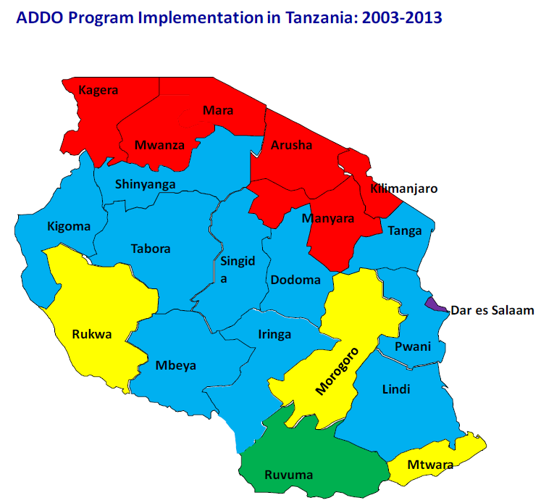
ADDO program status
As of August 2013
Regions scaled up | 21
Total no of drug shops | 9,226
Shops accredited (ADDOs) | 5,467
Shops on application process | 3,759
Trained dispensers | 13,302
Trained district inspectors | 262
Trained ward inspectors | 3,000
Notes:
60% of all existing drug shops have been accredited in 121 districts

Slide 7
Effect of ACT subsidy in PMI pilot region
Notes:
PMI supported delivery of subsidized ACT in 700 ADDOs in two regions of Ruvuma and Morogoro, where availability increased to 40%.

Slide 9
Spatial distribution of AMFm-ACT stocking over five surveys

Slide 10
Encounters receiving appropriate malaria treatment in Ruvuma region
ADDO
Notes:
Tanzania
July 2011, 49% (3484/7122) of drug shops accredited in 14/21 regions
7, 226 dispensers trained
ACT delivery in ADDOs supported by US PMI (2 regions) and AMFm (whole country)

Slide 11
ADDO model transfer to other countries—Uganda’s Accredited Drug Shops
As of August 2013, 409 ADS accredited in Kibaale, Kamwenge, Kyenjojo, Mityana, and Kamuli districts
721 ADS sellers trained
93 local drug monitors trained
435 owners trained in business

Slide 12
Effect of ADS on availability of antimalarials in Uganda
Kibaale (intervention)
Mpigi (control)
Notes:
Experience from Uganda pilot provide such a powerful evidence on the impact of holistic approach (ADDO) to drug seller work on malaria. This slide indicate the following key results:
Overall, antimalarials availability (recommended first line ALu) increased in both the intervention district (Kibaale) and control (Mpigi) which is the results of many ongoing interventions to improve the availability of effective antimalarials in the private drug shop in the rural.
But the major impact of ADS intervention (regulatory enhancement and improved quality of services) is the significant decline of the availability of chloroquine and SP that are no longer recommended as first line antimalarials in Uganda.

Slide 13
Percent of drug shop encounters with appropriate malaria treatment in Uganda
Kibaale (intervention)
Mpigi (control)
Notes:
There is 31% difference in the % of encounter where appropriate of malaria treatment provided in the Kibaale where ADS was implemented than in Mpigi where other intervention are going on.

Slide 14
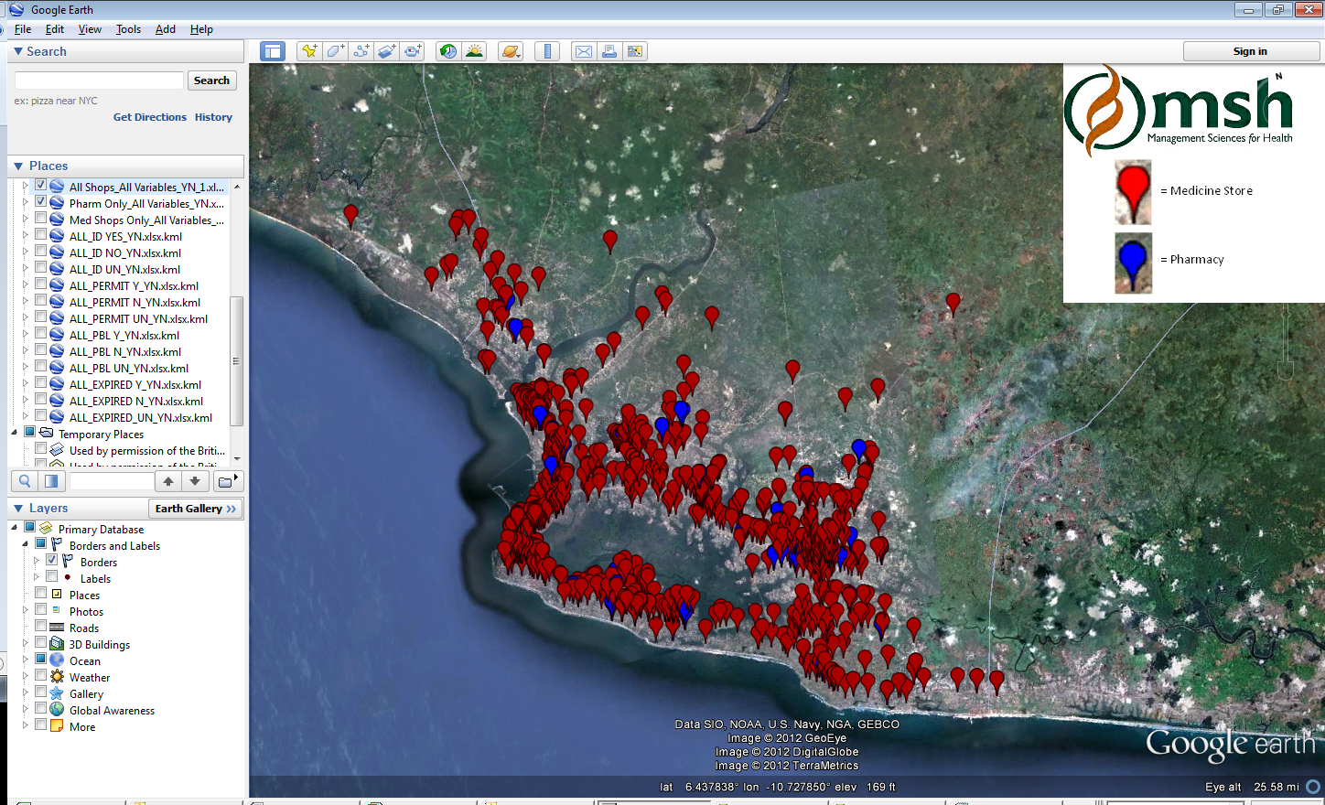
ADDO model transfer to other countries—Liberia’s Accredited Medicine Stores

Slide 15
Access to rapid diagnostic tests in ADDOs
Tanzania’s National Malaria Control Program awaiting results of CHAI’s RDT pilot in two districts to make policy decision for scale-up
Discussions with Pharmacy Council and laboratory association agencies to address regulatory barriers to introducing RDTs in ADDOs

Slide 16
Challenges to RDTs
Many country regulations do not allow diagnostic services in retail pharmaceutical outlets
Keeping up-to-date records of sales transactions for ACTs and RDTs is a major challenge
Assuring that drug sellers adhere to diagnosis and treatment standards and requires intense monitoring
Public facilities reluctant to accept RDT results from drug sellers
Even with subsidies, ACTs and RDTs are expensive to stock
Notes:
Incentives and purchasing power: even at subsidized prices, maintaining sufficient inventory of ACTs and RDTs remains a challenge. Limited or no access to micro-loans for owners needs to be addressed.
Referral: Public facilities’ are reluctant to accept RDT negative results from private drug sellers.

Slide 17
What works?
ADDO model has improved access to ACTs by comprehensively addressing drug seller operations
Evidence suggests improved adherence to treatment standards and increase referrals of under-fives to public sector following accreditation
Availability of ACT at ADDOs result in drug stores serving as back-ups for public clinics with ACT stock-outs
Notes:
ADDO model has improved access to ACTs by addressing overall drug seller operations including: regulation, policy, business incentives, capacity building, product and services quality and consumer awareness and education

Slide 18
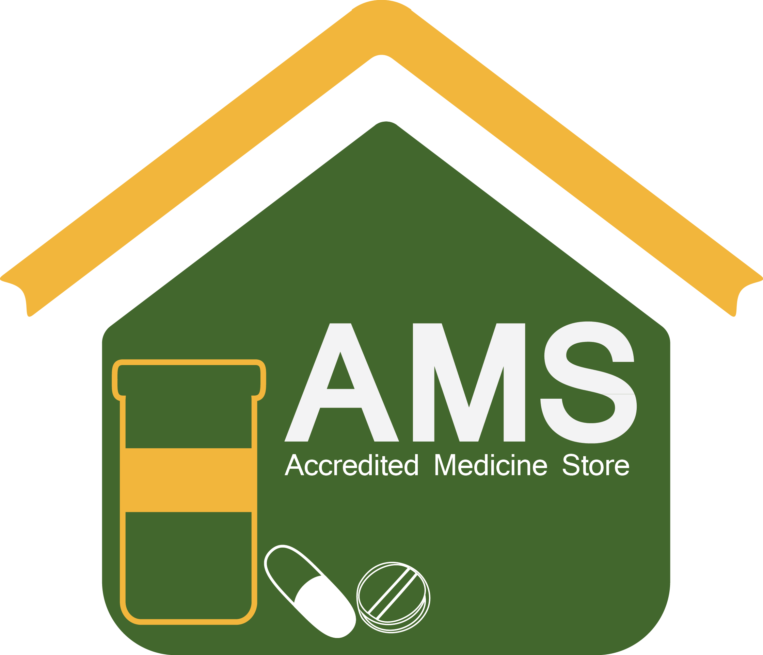
Asante Sana!

